Slide 1


JEDI Group-B FlipFit Gym Application
Flipfit : Your Gym Management App

Slide 2

Our Team

Slide 3
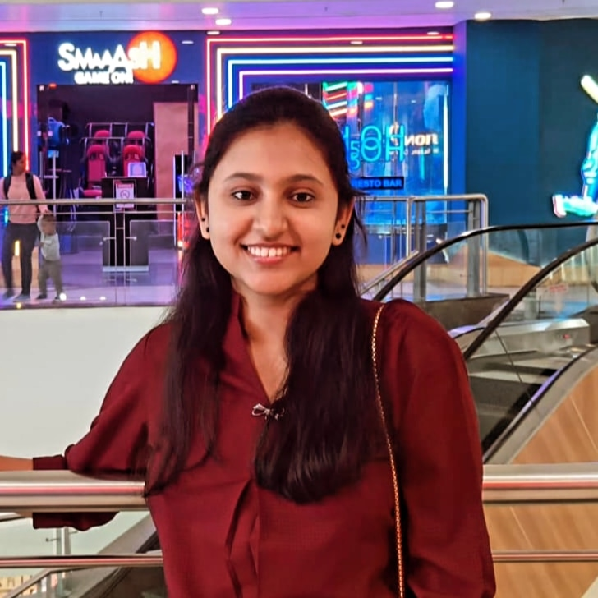
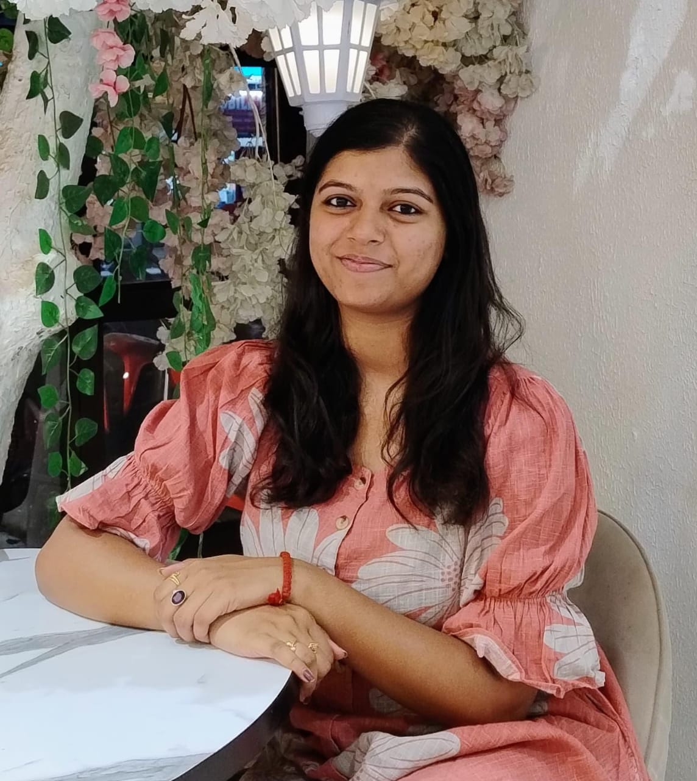

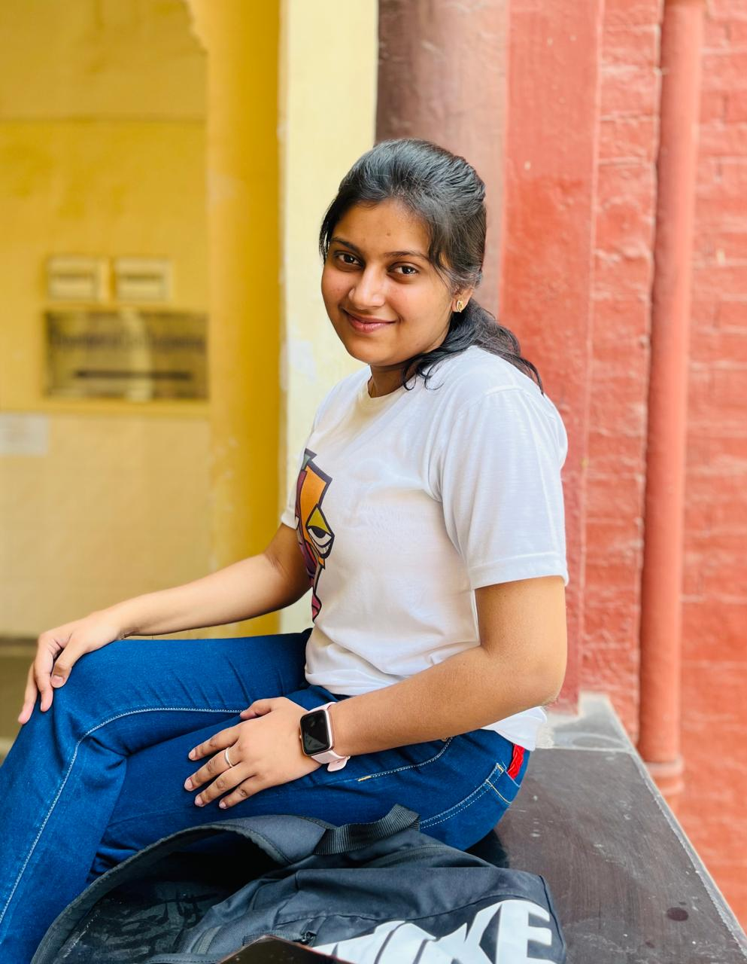


Vedashree Ranade
Team Leader
Purbasha Roy
Ananya Sudi
Tanvi Tanya
Garvika Joshi
Aena Ghai

Slide 4
Problem Statement
Design a UI and a backend system for a new enterprise application that Flipkart is launching, FlipFit. Flipkart is partnering up with gyms across Bangalore to enter into the fitness space. For the Beta launch the requirements are as follows:
Multiple centers in Bangalore
Fixed time slots and seat availability
Admin inputs slot info
User operations: Register, View, Book

Slide 5
Our next starts
NOW
Notes:
same

Slide 6
6 Days Of Training + Project Demo
6 DAYS
144 HOURS
8640 MINUTES
518400 SECONDS
LIMITLESS KNOWLEDGE

Slide 7
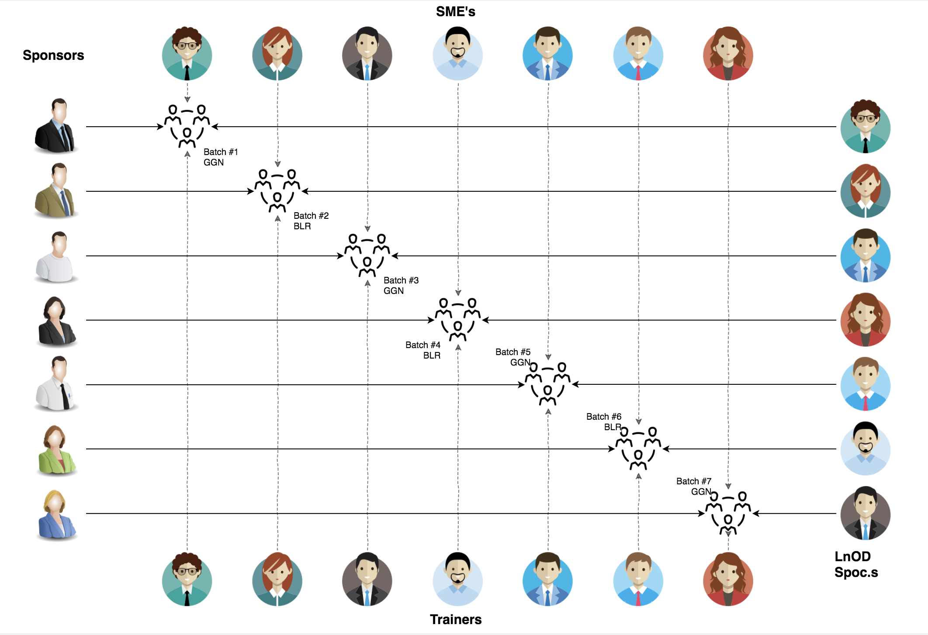
Stakeholders
Sponsors
Flipkart
SMEs Trainer
Mr. Amit Balyan
JEDI Coordinators
Ms Anushka Khanna

Slide 8

Agenda
Our Journey
Our Team
Team Structure
Project Goals
Engineering Practices
Tech Stack
Development
Challenges & Learnings
Demo of the Project
Questions
Notes:
mostyl same, 8th up dpwn

Slide 9

Our Journey
Notes:
process

Slide 10
Demo
Mindset
Process
5
Project Demo
Tools
4
Working on JAVA POS and DropWizard
Comprehend
3
Design Thinking: creating UML, activity diagrams, and use case diagrams and using solid principles, database schema
2
Decide the Technologies JAVA/DropWizard/MySQL
1
Understanding Project Goals
Notes:
modify acc to ours

Slide 11

Project Goals
Notes:
book gyms

Slide 12



Our Vision
To develop the FlipFit Gym Management System using full stack development tools and technologies, allowing gym owners to manage their gyms and slots, while customers can book gym sessions.
1
Quality
2
3
Interactivity
Availability

Slide 13

Engineering Practices
Notes:
Time – 5 mins

Slide 14
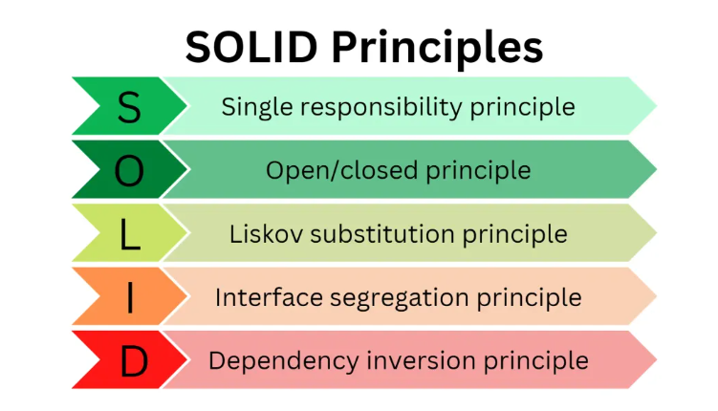

Slide 15
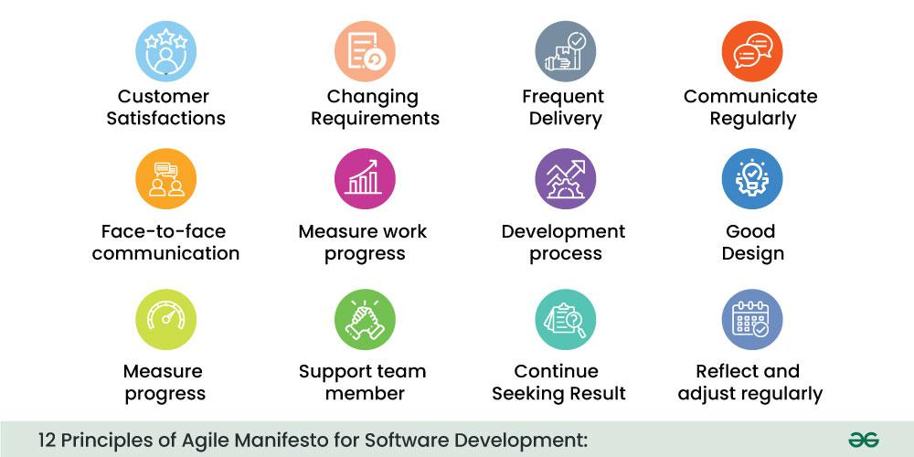

Slide 16
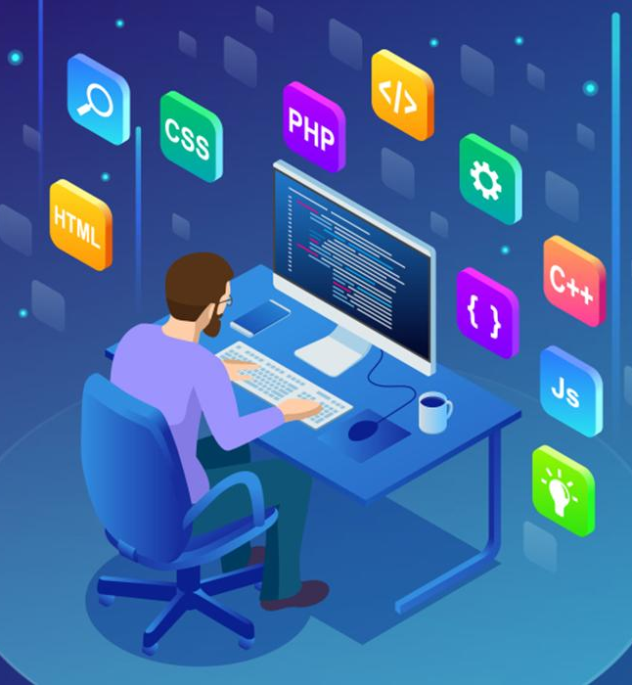
Tech Stack
Notes:
java intel

Slide 17









Backend
Data
Tools
IDE
Core Language
MySQL Database
Version Control, API Test
Version Control, API Test
Framework

Slide 18

Development
Notes:
Time – 1 min

Slide 19
Requirement understanding
Research and analysis
Estimation
User Registration and Viewing Centers
Slot Booking System
Availability Views
Sprint Planning
Sprint Grooming
Delivery
Sprint Implementation
LLD
UML Class Diagrams
Implementation
Commit and review
Integrate
Test

Slide 20

Challenges & Learnings
New Tech Stack
Designing Database Schema
Resolving merge conflicts
Build failures
Database Connection
Coordination

Slide 21

Demo

Slide 22

Questions

Slide 23
Thank you

